Slide 1
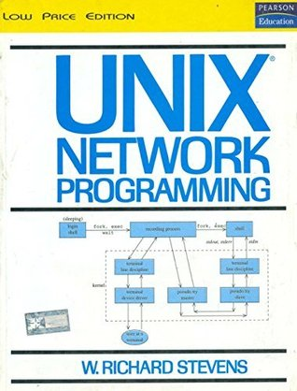
Network Programming

Slide 2
Network programming involves writing programs to communicate with processes either on the same or on other machines on the network using standard Protocols…

Slide 3
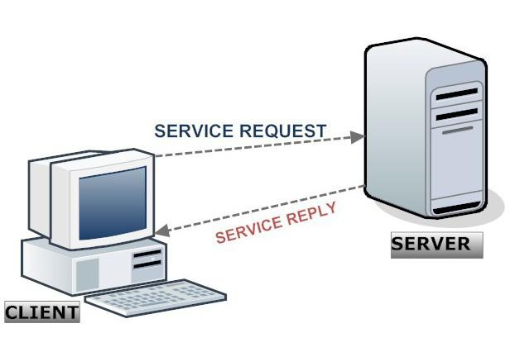
Introduction:
When writing programs that communicate across a computer network, one must first invent,
A protocol, an agreement on how those programs will communicate.
High-level decision must be made as to which program would initiate the communication first and when responses are expected…
Example,
WebServer program waits for clients to send request and only after the request is received it responds with a reply…

Slide 4
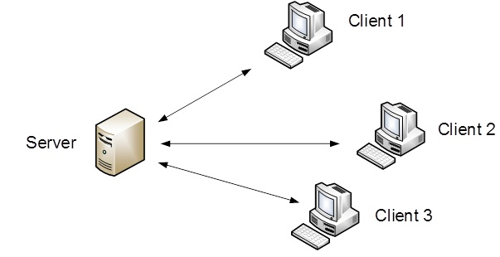
Single Server – Serving multiple Clients
Clients normally communicate with one server at a time, although using a Web browser , communication might happen with many different Web servers over, in specific time period.
The client and the server application may be thought of as communicating via a network protocol, but actually, multiple layers of network protocols are typically involved.

Slide 5
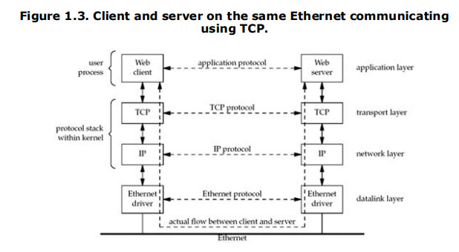
Internet protocol suite
Web clients and servers communicate using the Transmission Control Protocol, or TCP. TCP, in turn, uses the Internet Protocol, or IP, and IP communicates with a datalink layer of some form. Below fig depicts when client and server are on the same Ethernet,

Slide 6
Client and server communicate using an application protocol. Transport layers communicate using TCP.
Actual flow of information between the client and server goes down the protocol stack on one side, across the network, and up the protocol stack on the other side. Also client and server are typically user processes, while the TCP and IP protocols are normally part of the protocol stack within the kernel.
Ethernet standards used in Ethernet networks. It uses UTP (Cat3 or higher) cables and Hubs. Hubs use a physical star topology and a logical bus topology.
Hubs repeat and forward signals to all nodes.

Slide 7
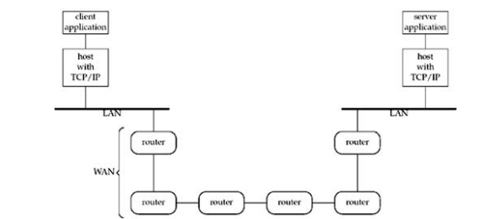

Slide 8
https://www.youtube.com/watch?v=1z0ULvg_pW8

Slide 9
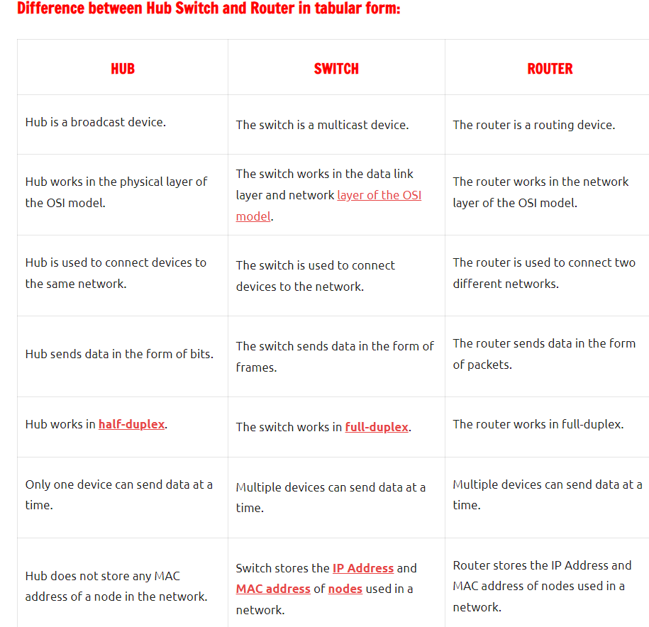

Slide 10
Types of protocols
Protocols can be broadly classified into three major categories-
Communication : These protocols formally set out the rules and formats through which data is transferred. These protocols handle syntax, semantics, error detection, synchronization, and authentication.
Eg : HTTP, TCP, UDP, BGP, ARP, IP, DHCP,
Management : These protocols assist in describing the procedures and policies that are used in monitoring, maintaining, and managing the computer network. These protocols also help in communicating these requirements across the network to ensure stable communication.
Eg: FTP, Telnet
Security: These protocols secure the data in passage over a network. These protocols also determine how the network secures data from any unauthorized attempts to extract or review data.
Eg: SSL, HTTPS, TSL

Slide 11
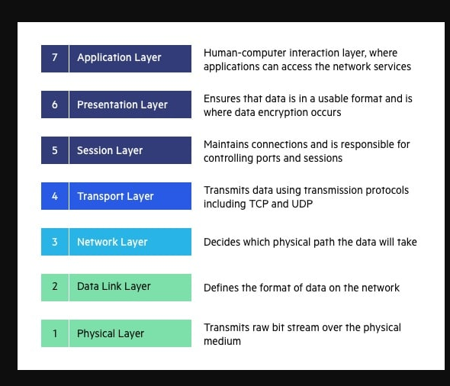
Functions of OSI Layers

Slide 12
Types of Network Protocols with Functions
TCP and UDP protocols
Both protocols allow network applications to exchange data between nodes. The main difference between both is that TCP is a connection-oriented protocol while UDP is a connectionless protocol.
When the TCP protocol is used, a special connection is opened up between two network devices, and the channel remains open to transmit data until it is closed. On the other hand, a UDP transmission does not make a proper connection and merely broadcasts its data to the specified network address without any verification of receipt.
IP protocol
Internet Protocol is connectionless and unreliable protocol. It ensures no guarantee of successfully transmission of data.
In order to make it reliable, it must be paired with reliable protocol such as TCP at the transport layer.
Internet protocol transmits the data in form of a datagram.
Secure SHell (SSH)
It is a cryptography-based network protocol for operating network services securely and reliably over an unsecured network. Some particular applications include remote command-line, remote command execution, login, but any network service can be made secure with the help of SSH.

Slide 13
Continued…
Internet Relay Chat (IRC) Protocol
uses a client-server model to provide a chatroom.
A single IRC server is set up, and users connect to the server via IRC clients. The protocol allows users to set usernames on the server and engage in private chats or group chats via different IRC channels.
Internet Message Access Protocol (IMAP)
It is an Internet email protocol that stores emails on the mail server but allows the end-user to retrieve, see, and manipulate the messages as they were stored locally on the user’s devices.
Domain Name Service Protocol(DNS)
DNS stands for Domain Name Service. This service allows us to access a node by its name. By default, nodes use IP addresses to identify each other on the network. DNS service allows us to map a name to an IP address. When we access a node by its name, the DNS service translates the name into the IP address. Let's take an example.

Slide 14
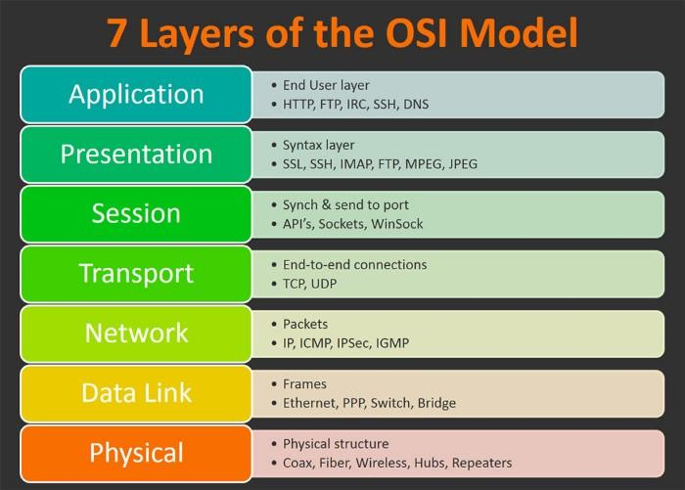
Protocols associated with all the Layers of OSI - Model

Slide 15
The TCP/IP model is a concise version of the OSI model. It contains four layers, unlike seven layers in the OSI model. The layers are:
Process/Application Layer
Host-to-Host/Transport Layer
Internet Layer
Network Access/Link Layer

Slide 16
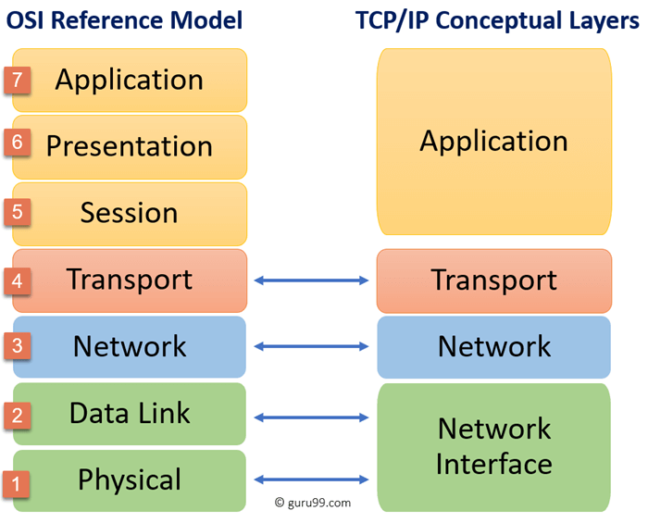
TCP/IP Model

Slide 17
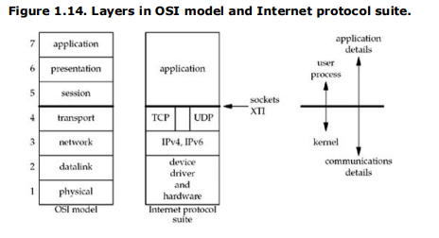
Need of Socket Programming: The sockets programming interfaces are the interfaces from the upper three layers (the "application") into the transport layer. There are 3 reasons why sockets provide interface from the upper three layers of the OSI model into the Transport Layer.

Slide 18
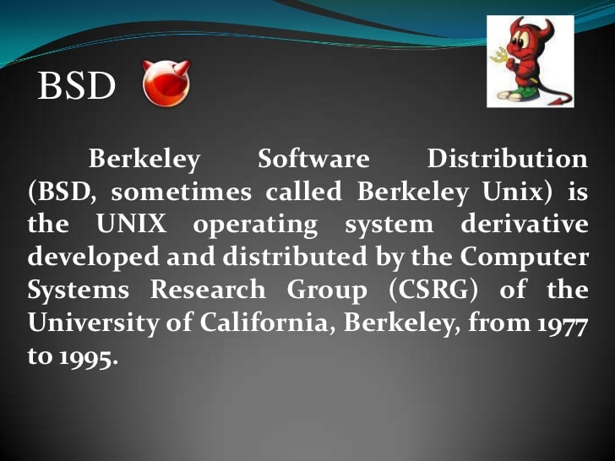
BSD

Slide 19
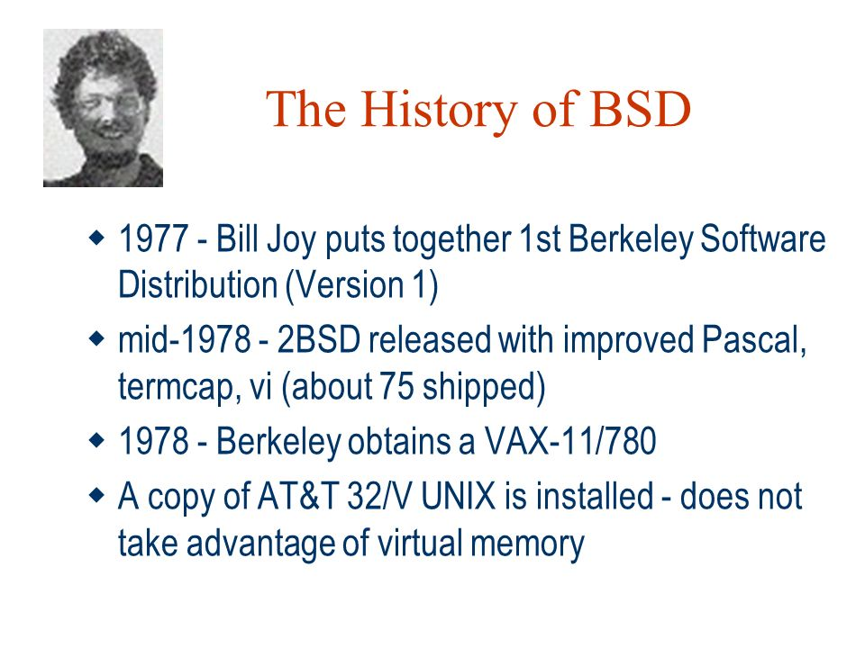
BSD

Slide 20
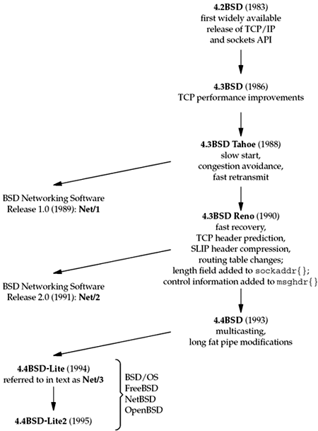
BSD History

Slide 21
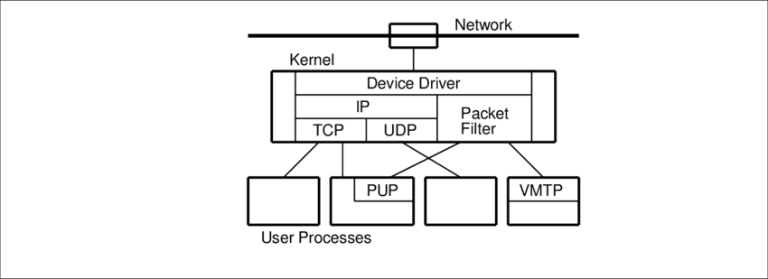

BSD Network
Potentially Unwanted Applications
Versatile Message Transaction Protocol

Slide 22
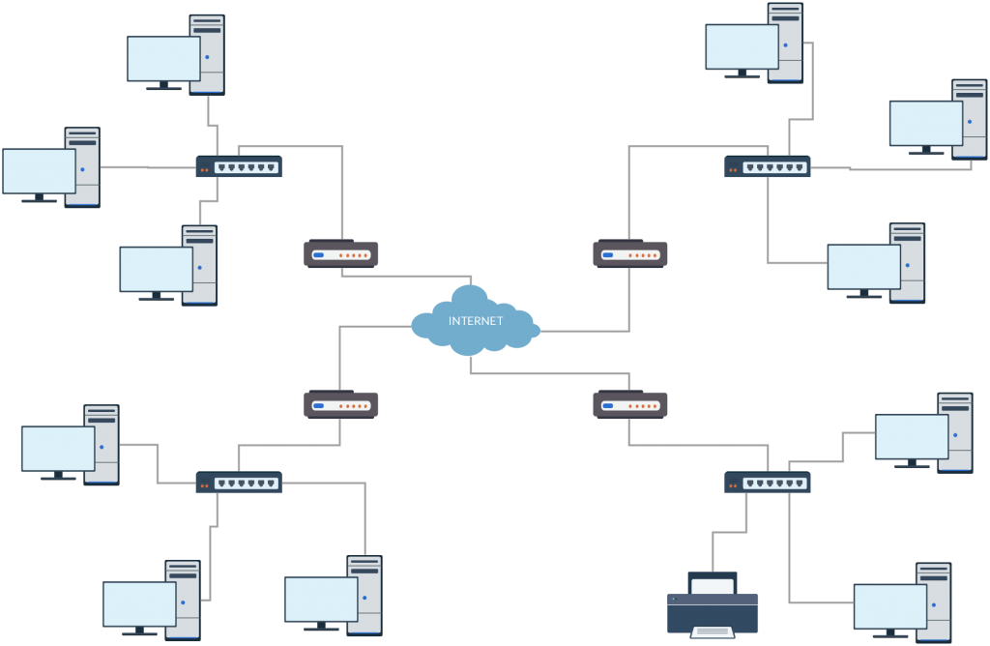
Test Network and Hosts

Slide 23
For each host, the OS and the type of hardware (since some of the operating systems run on more than one type of hardware) is shown. The name within each box is the hostname that appears in the text.
Machines are largely spread out across the Internet and virtual private networks (VPNs) or secure shell (SSH) connections provide connectivity between these machines regardless of where they live physically.
Although there are no current Unix standards with regard to network configuration and administration, two basic commands are provided by most Unix systems and can be used to discover some details of a network netstat and ifconfig.

Slide 24
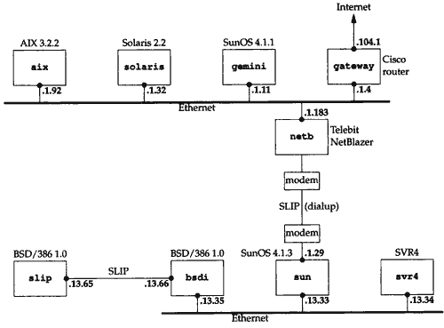
Test Network and Hosts

Slide 25
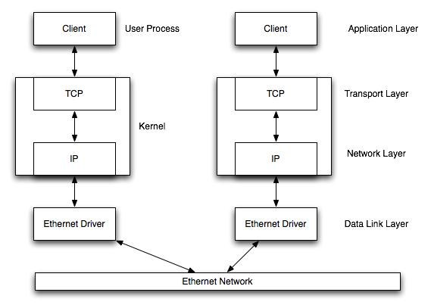
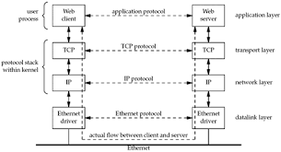
Communication over LAN

Slide 26
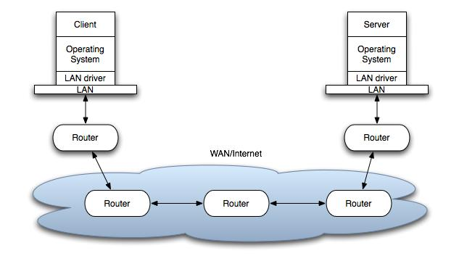
Communication over WAN

Slide 27
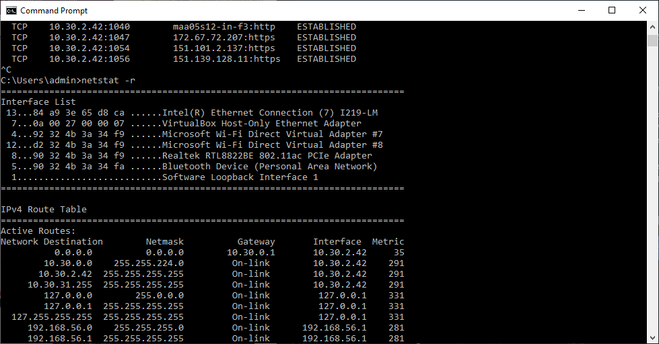
Discovering Network Topology – netstat –ni and netstat -r
Options | Meaning
-a | All ( TCP, UDP, SCTP, ICMP )
-n | Numeric addresses
-b | Display executables
-o | Process id
-f | Fully Qualified domain name
-p proto | Specific protocols
-r | Routing table
-s | Protocol statistics
-t | Current connection network status

Slide 28
The netstat command, meaning network statistics, is a Command Prompt command used to display very detailed information about how your computer is communicating with other computers or network devices.
# netstat –a : Shows both listening and non-listening sockets.
# netstat –l : List only listening ports.
# netstat –lt : List only listening TCP ports.
# netstat –c : Print the netstat information continuously every few seconds.

Slide 29
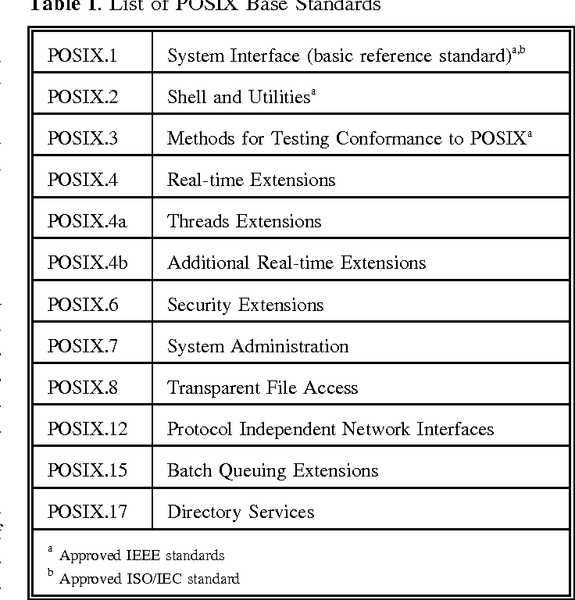
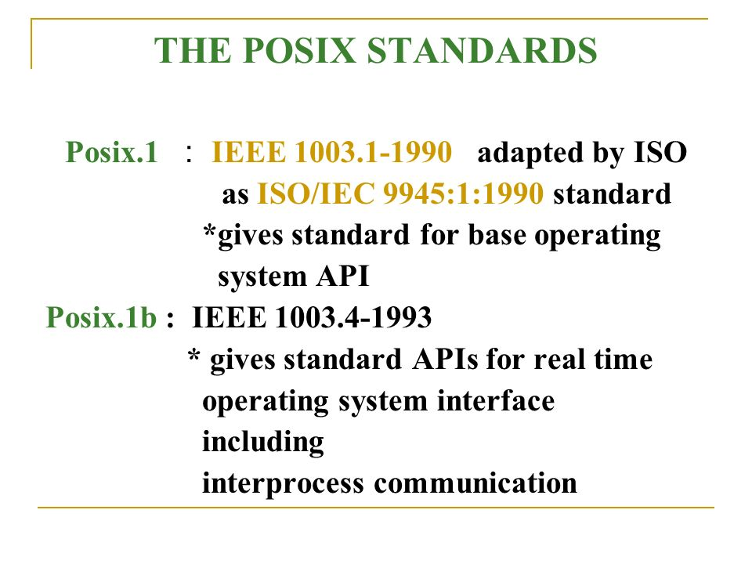
Unix Standard - POSIX
Posix.1c : Threads and Extensions

Slide 30
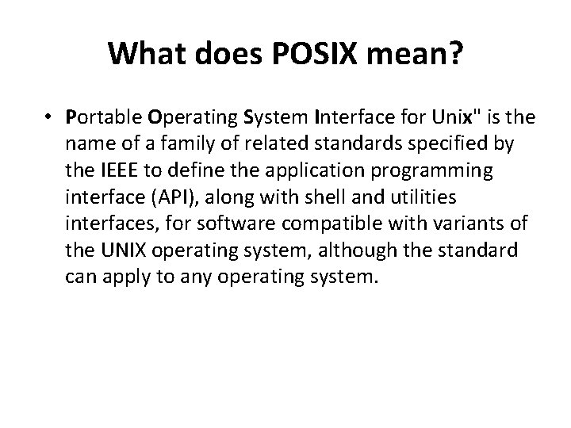
Unix Standard - POSIX

Slide 31
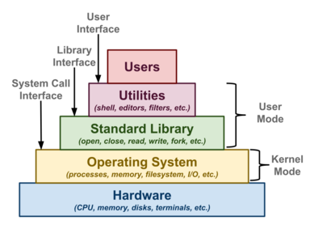
Unix APIs

Slide 32
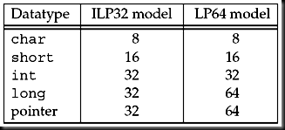
64 Bit Architectures : The common programming model for existing 32-bit Unix systems is called the ILP32 model, that denotes,
integers (I), long integers (L), and pointers (P) occupy 32 bits.
The model for 64-bit Unix systems is called the LP64 model, that denotes,
long integers (L) and pointers (P) require 64 bits.
Figure below compares these two models.

Slide 33
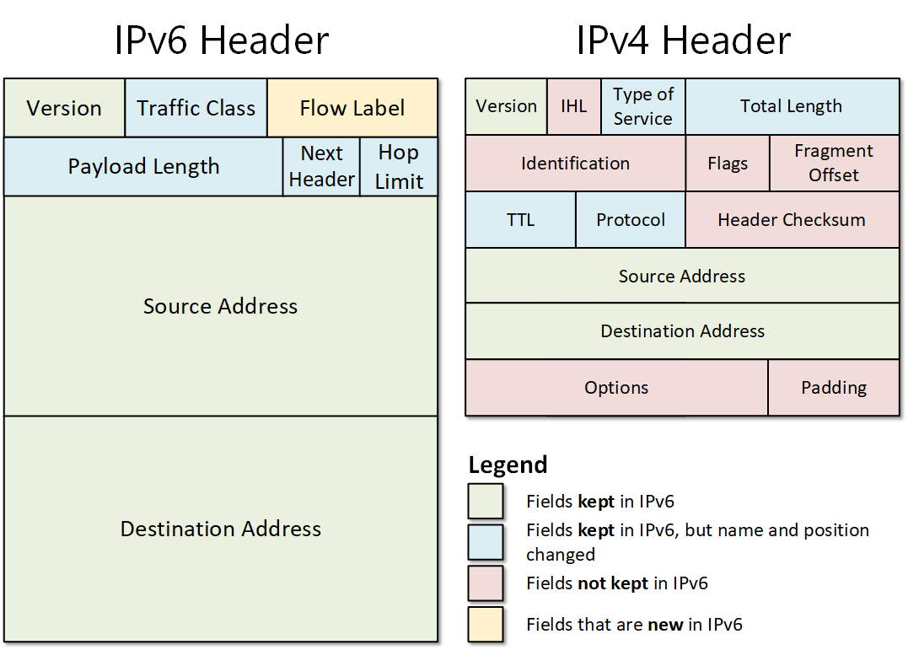
64 Bit Architectures

Slide 34
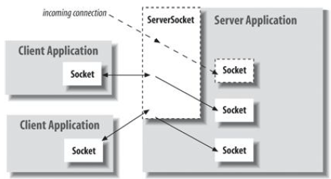
Sockets : An end point for communication between processes across the network

Slide 35
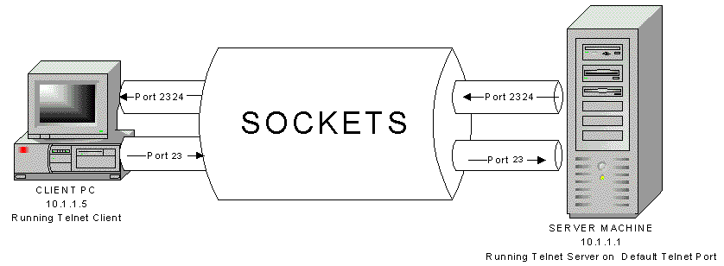
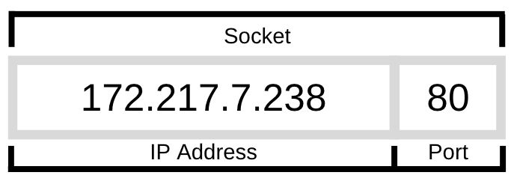
Sockets : An end point for communication between processes across the network

Slide 36
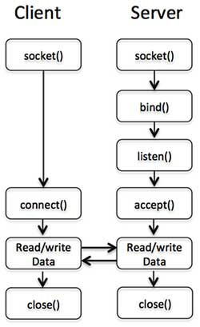
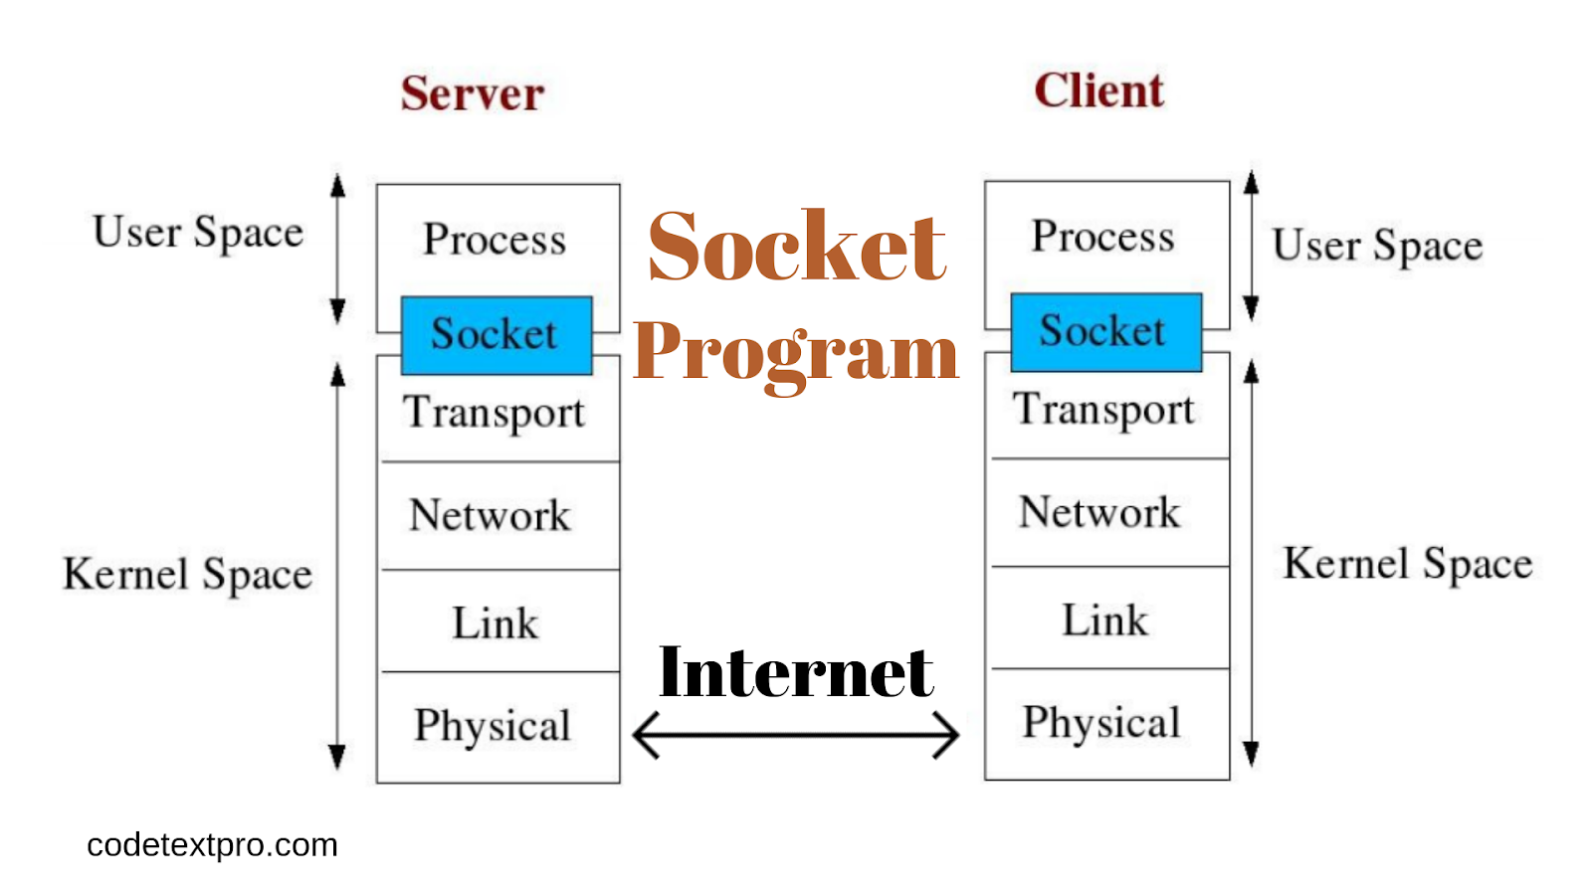
Connection between Day Time Server and client at port no. 13
Example :
Day Time Client….

Slide 37
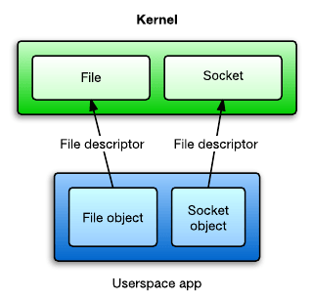
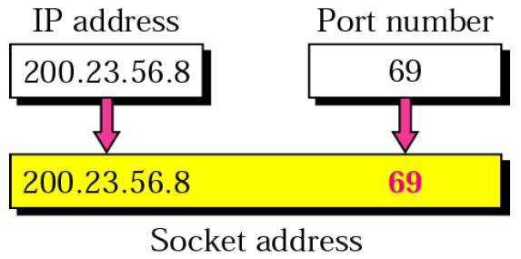
}
#include <unp.h> // includes system headers & constants
int main(int argc, char **argv)
{
int sockfd, n = 0;
char recvline[MAXLINE + 1];
struct sockaddr_in servaddr;
if(argc != 2)
err_quit("usage: a.out <Ipaddress>");
if ((sockfd = socket(AF_INET, SOCK_STREAM, 0)) < 0) {
err_sys( "Socket Error");
}
bzero(&servaddr, sizeof(servaddr));
servaddr.sin_family = AF_INET;
servaddr.sin_port = htons(13); //Daytime server
if( inet_pton(AF_INET,argv[1],&servAddress.sin_addr <= 0)
err_quit(" inet_pton error for %s", argv[1]);
if (connect(sockfd, (SA *) &servaddr, sizeof(servaddr)) < 0) {
err_sys( "Connect Error");
}
Source Code of Day Time Client
AF_APPLETALK | Apple Computer Inc. Appletalk network
AF_INET | Internet domain
AF_PUP | Xerox Corporation PUP internet
AF_UNIX | Unix file system
127.0.0.1 -- > b'\x7f\x00\x00\x01'

Slide 38
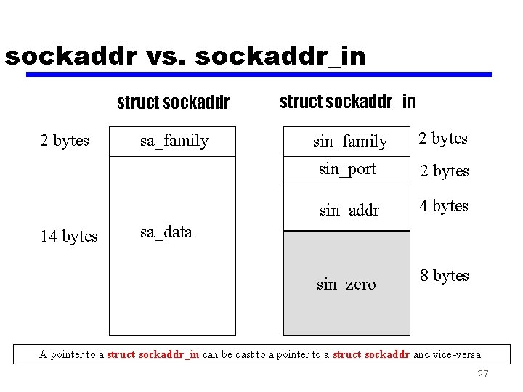
while ((n = read(sockfd, recvline, MAXLINE)) > 0) {
recvline[n] = 0; //null terminate
if(fputs(recvline,stdout) == EOF)
err_sys("fputs error");
}
if((n<0)
err_sys("read error");
exit(0);
}
Input 206.168.112.96
Output Mon May 26 20:58:40 2003

Slide 39
DayTime Server…
#include "unp.h“
#include <time.h>
int main(int argc, char **argv)
{
int listenfd, connfd;
struct sockaddr_in servaddr;
char buff[MAXLINE];
time_t ticks;
listenfd = Socket(AF_INET, SOCK_STREAM, 0);
bzeros(&servaddr, sizeof(servaddr));
Serveraddr.sin_family=AF_INET;
Serveraddr.sin_addr.s_addr=hton1(INADDR_ANY); //IP address of client on any interface.
Serveraddr.sin_port=htons(13);
Bind(listenfd, (SA *) &servaddr, sizeof(servaddr));
Listen(listenfd, LISTENQ); // convert socket to listening socket.
// LISTENQ- A queue of No of client connections
// 3 steps to prepare listenfd are, socket, bind & listen.

Slide 40
for (;;) {
connfd = Accept(listenfd, (struct SA *) NULL, NULL);
//connected descriptor
ticks = time(NULL);
snprintf(buff, sizeof(buff), "%.24s\r\n", ctime(&ticks)); // carriage return & line feed are appended
write(connfd, buff, strlen(buff));
close(connfd);
}
}
Listen on the Port for connections
Accept connection request from Client
Write to socket… { Serve the Client }

Slide 41
}
int main()
{
int s;
struct sockaddr_in6 addr;
s = socket(AF_INET6, SOCK_STREAM, 0);
addr.sin6_family = AF_INET6;
addr.sin6_port = htons(5000);
inet_pton(AF_INET6, "::1", &addr.sin6_addr);
connect(s, (struct sockaddr *)&addr, sizeof(addr));
while ((n = read(sockfd, recvline, 1000)) > 0) { recvline[n] = 0; fputs(recvline, stdout); }
close(sockfd);
return 0;
}
Source Code of Day Time Client – IPV6

Slide 42
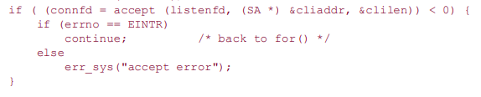
}
Error Handling and Wrapper functions
In any real-world program, it is essential to check every function call for an error return. we check for errors from socket, inet_pton, connect, read, and fputs, and when one occurs, we call our own functions, err_quit and err_sys, to print an error message and terminate the program.
Most of the time, this is what we want to do. Occasionally, we want to do something other than terminate when one of these functions returns an error .

Slide 43
Continued…
Programs can be shortened by defining a wrapper function that performs the actual function call, tests the return value, and terminates on an error. The convention we use is to capitalize the name of the function, as shown below.
sockfd = Socket(AF_INET, SOCK_STREAM, 0);
Many system calls will report the EINTR error code if a signal occurred while the system call was in progress. No error actually occurred, it's just reported that way because the system isn't able to resume the system call automatically. This coding pattern simply retries the system call when this happens, to ignore the interrupt.
wrapper function for the socket function
int Socket(int family, int type, int protocol)
{ int n;
if((n=socket(family, type, protocol)) < 0)
err_sys(“socket error);
return(n);
}

Slide 44
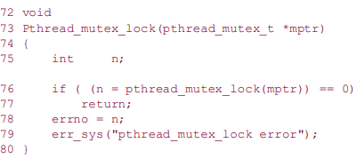
Wrapper function for pthread_mutex_lock.
A mutual exclusion object (mutex) is a program object that allows multiple program threads to share the same resource, such as file access, but not simultaneously. When a program is started, a mutex is created with a unique name. After this stage, any thread that needs the resource must lock the mutex from other threads while it is using the resource. The mutex is set to unlock when the data is no longer needed or the routine is finished.

Slide 45
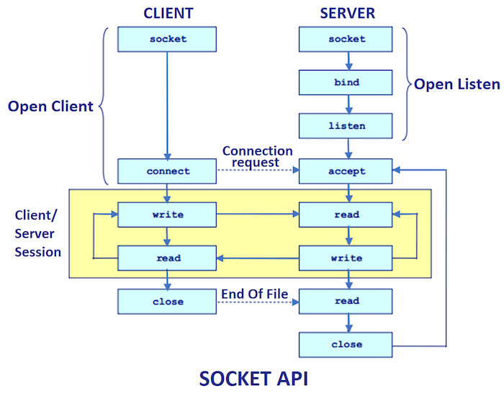

Slide 46
Transport Layer: TCP, UDP and SCTP
SCTP(Stream Control Transmission Protocol (SCTP)) is a reliable, message-oriented transport layer protocol. These transport protocols use the network-layer protocol IP, either IPv4 or IPv6. It maintains the message boundaries and detects the lost data, duplicate data as well as out-of-order data.
SCTP provides the Congestion control as well as Flow control.
UDP is a simple, unreliable datagram protocol.
TCP is a sophisticated, reliable byte stream protocol.
SCTP is similar to TCP as a reliable transport protocol, but it also provides message boundaries, transport-level support for multihoming, and a way to minimize head-of-line blocking.

Slide 47
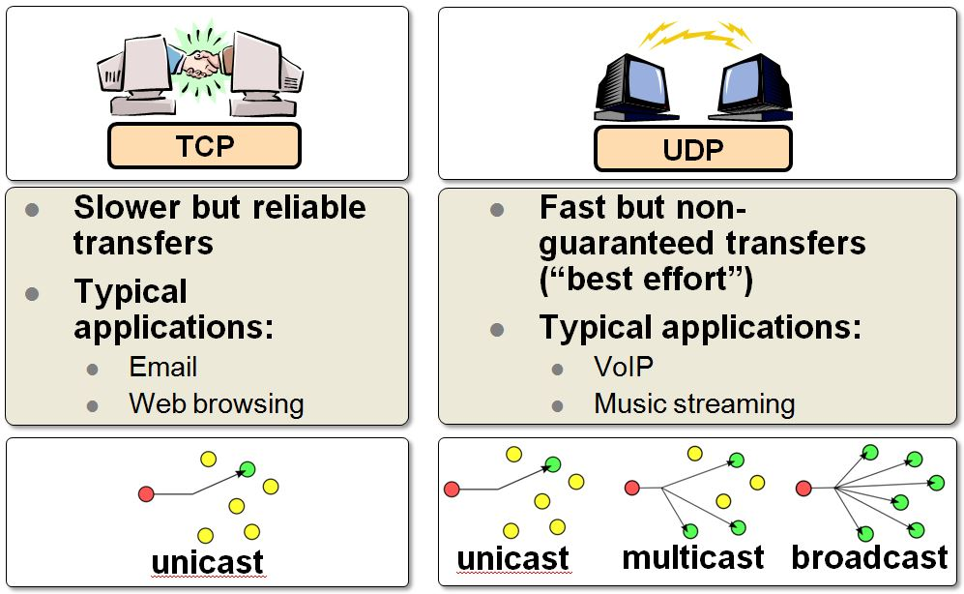
}
TCP AND UDP

Slide 48
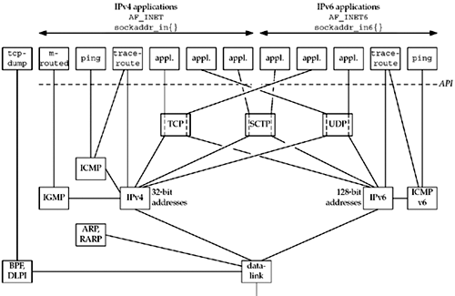
}
TCP/IP – The Big-picture

Slide 49
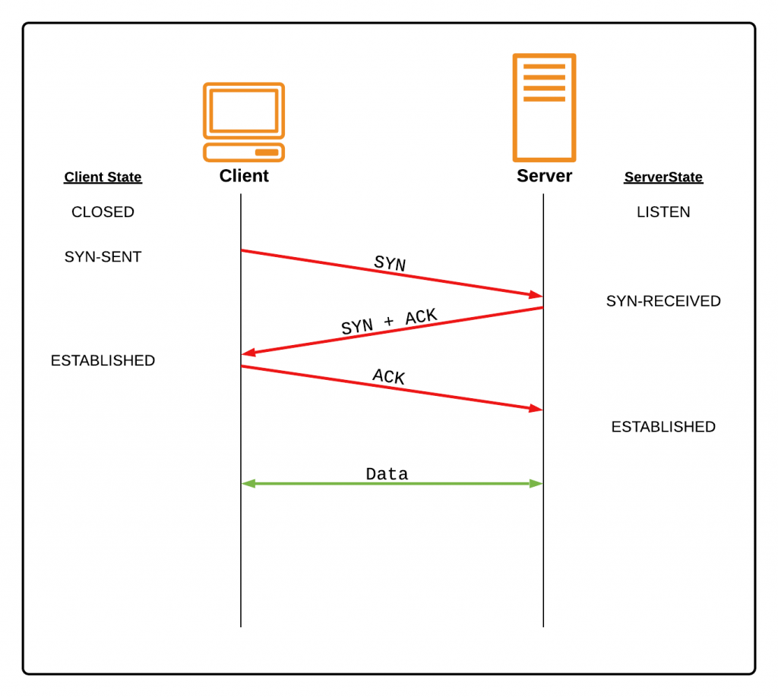
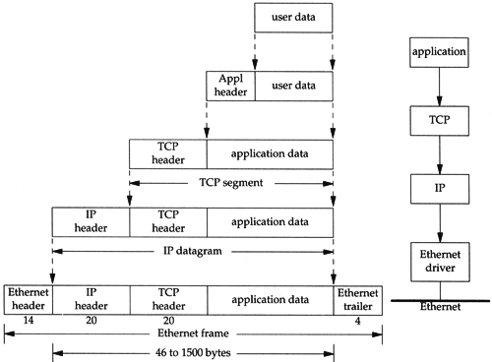
}
TCP - Connection

Slide 50
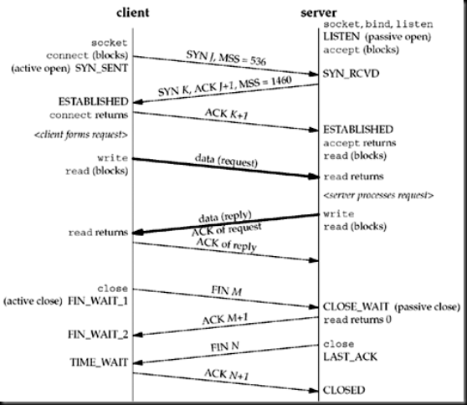
TCP – Connection : Packet Exchange

Slide 51
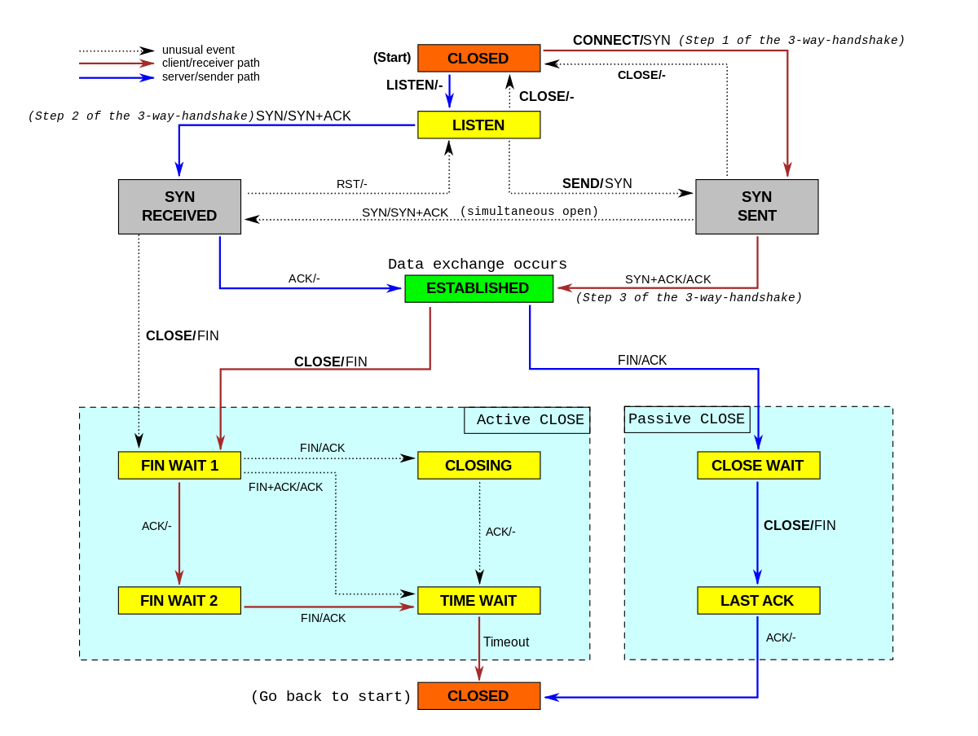
TCP-Connection state diagram

Slide 52
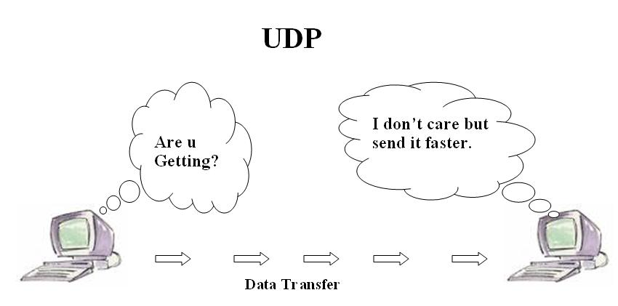
}
UDP

Slide 53
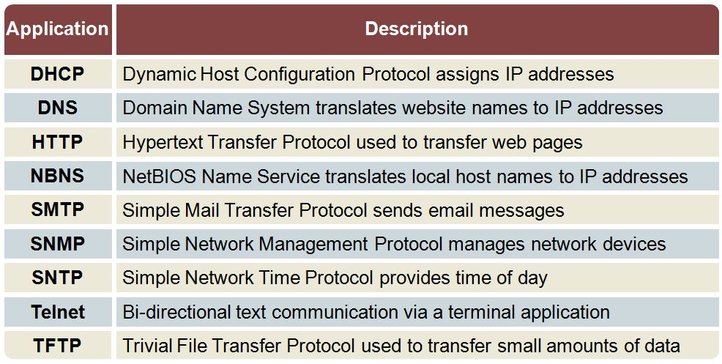
}
TCP Use cases

Slide 54
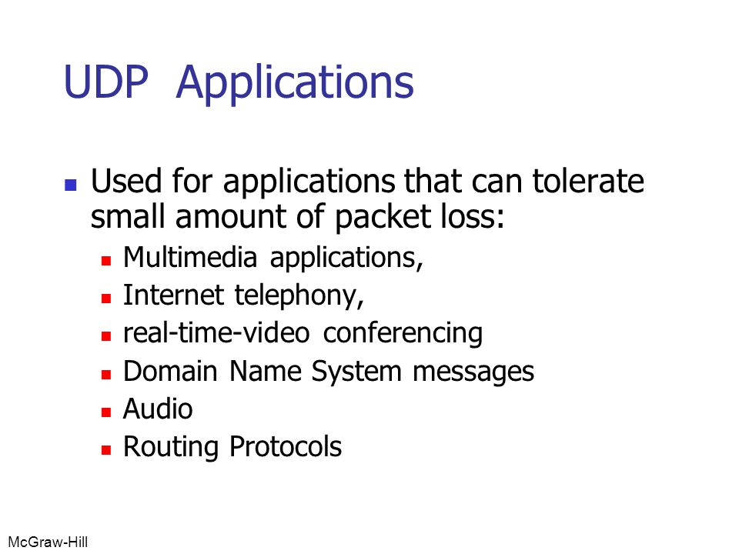
}
UDP Use cases

Slide 55
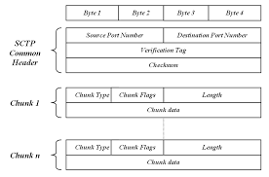
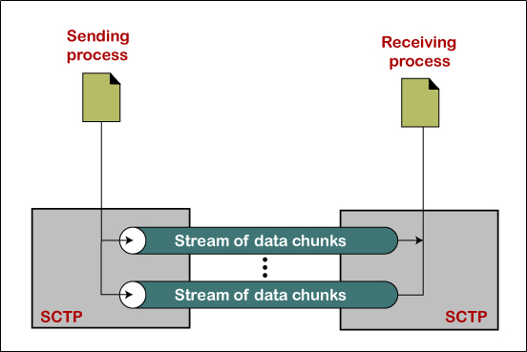
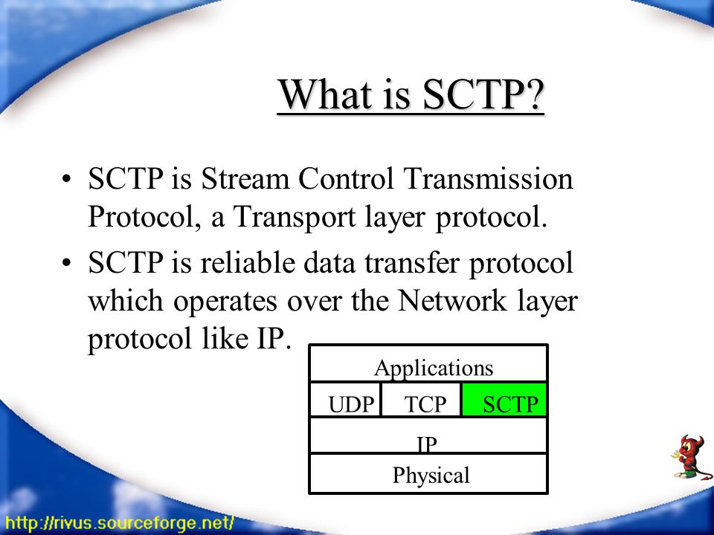
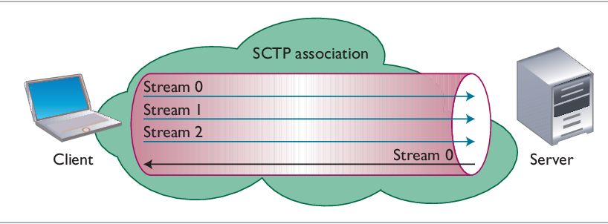
SCTP

Slide 56

}
SCTP

Slide 57

}
TCP Connection Termination
Packets exchanged when a TCP connection is closed – Takes 4 segments to terminate the connection.
Calls close first. ( Active close)
Passive close at the other end.
Application will not receive any Data after this. Closes socket and sends a FIN.
Acknowledges the FIN.

Slide 58
}
TCP – Options
Each SYN can contain TCP options. Commonly used options include the following:
MSS option: With this option, the TCP sending the SYN announces its maximum segment size, the maximum amount of data that it is willing to accept in each TCP segment, on this connection. The sending TCP uses the receiver's MSS value as the maximum size of a segment that it sends.
Window scale option: The maximum window that either TCP can advertise to the other TCP is 65,535, because the corresponding field in the TCP header occupies 16 bits. But, high-speed connections, common in today's Internet (45 Mbits/sec and faster, as described in RFC 1323 [Jacobson, Braden, and Borman 1992]), or long delay paths (satellite links) require a larger window to obtain the maximum throughput possible. This newer option specifies that the advertised window in the TCP header must be scaled (left shifted) by 0–14 bits, providing a maximum window of almost one gigabyte (65,535 x 214). Both end-systems must support this option for the window scale to be used on a connection.
Timestamp option: This option is needed for high-speed connections to prevent possible data corruption caused by old, delayed, or duplicated segments. Since it is a newer option, it is negotiated similarly to the window scale option. As network programmers there is nothing we need to worry about with this option.

Slide 59

Comparison

